Slide 1

Predicting customer buying behaviour
17/06/2023

Slide 2
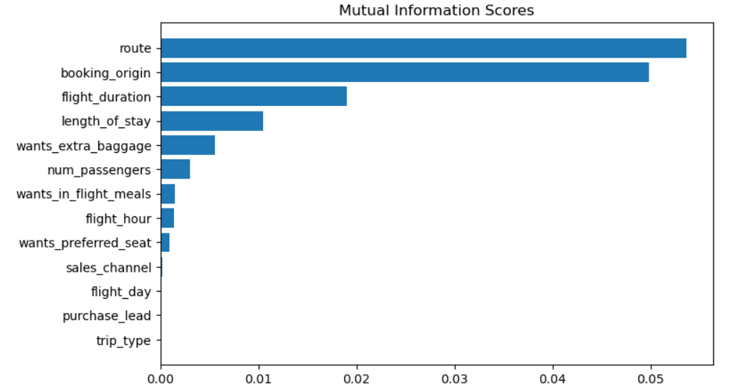
predictive model to understand factors that influence buying behaviour.
We have trained the data set with Random forest classifier model and received
ACCURACY: 85.05
AUC score: 0.54
route
booking_origin
flight_duration
length_of_stay
wants_extra_baggage
are the top 5 features which influence
Customer buying behavior
We need to increase the AUC score.

